Slide 1
Computer Architecture (CS-211)
Recitation 4
Song Wen

Slide 2


CS 211 Computer Architecture
TA Information
Name : Song Wen
Email : song.wen@rutgers.edu
If you need to send an e-mail, please use [CS-211] as prefix in your Email Subject!
Section 06 Recitation: Tuesday 9:00 AM - 9:55 AM Section 07 Recitation: Wednesday 9:00 PM - 9:55 PM
Office Hours : Tuesday 10:30 AM – 11:30 AM
https://rutgers.webex.com/meet/sw978
2

Slide 3
CS 211 Computer Architecture
Topics
Memory Structure in C
Dynamic Memory Allocation
Double Pointers
* Some materials are collected and compiled from previous year's CS 211 lectures and TAs

Slide 4


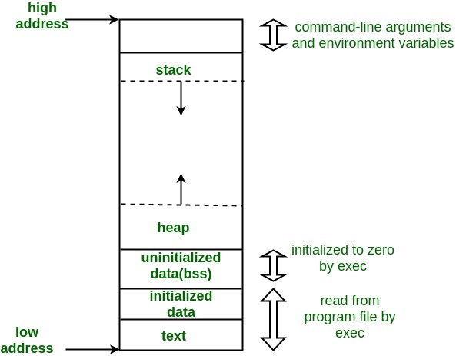
Memory Structure in C
CS 211 Computer Architecture
Stack, Heap, and Data
Reference link: https://stackoverflow.com/questions/79923/what-and-where-are-the-stack-and-heap
Stack
Contains local variables and parameters
Only created when the function is called
Heap
Grows to larger addresses
Managed by programmer (malloc, realloc, and free)
Data segment
Contains any global or static variables
The size is determined by the size of the values in the program code, and does not change at run time

Slide 5
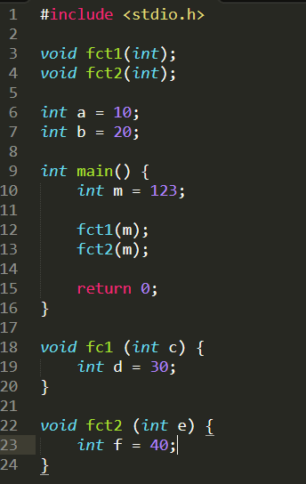
Memory flow example
CS 211 Computer Architecture
Line 6,7 : global variable
a = 10, b = 20
Data
Heap
Stack
jaewoo.joo@cs.rutgers.edu

Slide 6
Memory flow example
CS 211 Computer Architecture
Line 10 : local variable
a = 10, b = 20
Data
Heap
m = 123
Stack
jaewoo.joo@cs.rutgers.edu

Slide 7
Memory flow example
CS 211 Computer Architecture
Line 10, 12 : local variable
a = 10, b = 20
Data
Heap
c = 123, d = 30 (fct1) m = 123 (main)
Stack
jaewoo.joo@cs.rutgers.edu

Slide 8
Memory flow example
CS 211 Computer Architecture
Line 10, 13 : local variable
a = 10, b = 20
Data
Heap
e = 123, f = 40 (fct2)
c = 123, d = 30 (fct1) m = 123 (main)
Stack
jaewoo.joo@cs.rutgers.edu

Slide 9
Memory flow example
CS 211 Computer Architecture
End function main, fct1, fct2
a = 10, b = 20
Data
Heap
e = 123, f = 40 (fct2)
m = 123 (main)
Stack
jaewoo.joo@cs.rutgers.edu

Slide 10
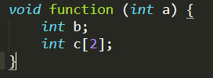
Memory allocation
CS 211 Computer Architecture
The memory allocated in stack and data segment will be determined when it is compiling
How much memory do we need?
a-4, b-4, c-8 -> total-16 bytes

Slide 11
Dynamic Memory Allocation
CS 211 Computer Architecture
Allocating memory inside the heap
Malloc(), realloc(), free()
These functions are containted in <stdlib.h> header file
To provide access to locations, malloc() returns the address of the first location that is reserved
Address must be assigned to a pointer
Especially useful for creating arrays

Slide 12
Dynamic Memory Allocation
CS 211 Computer Architecture
Malloc ()
Reserves the number of bytes requested by the argument passed to function
Returns the address of the first reserved location
NULL if there is insufficient memory
Realloc ()
Changes the size of previously allocated memory to new size
Free ()
Releases a block of bytes previously reserved
The address of the first reserved location is passed as an argument to the function

Slide 13
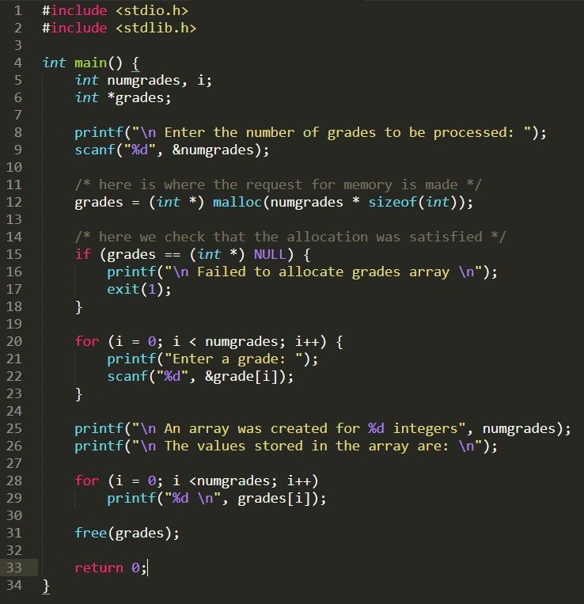
Dynamic Memory Allocation
CS 211 Computer Architecture
Restore the allocated block of storage back to the oper ating system at the end
.rutgers.edu

Slide 14
Dynamic Memory Allocation
CS 211 Computer Architecture
Enter the number of grades to be processed: 4
Enter a grade: 85 Enter a grade: 96 Enter a grade: 77 Enter a grade: 92
An array was created for 4 integers The values stored in the array are:
85
96
77
92
.rutgers.edu

Slide 15
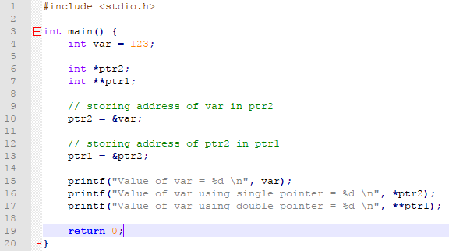
Double Pointer
CS 211 Computer Architecture
Declaring a pointer to pointer
– int **ptr;
ptr1 0x1000
0x2000
ptr2 0x0010
0x1000
var 123
0x0010
value addr
Notes:
The usual pointer holds the address of a variable inside. And a double pointer, taking a storage locker as an example, has its own address, but it holds the address of another safe in its contents.

Slide 16
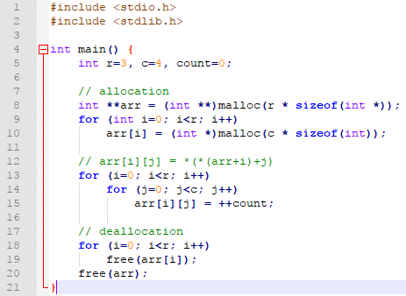
2D Memory Allocation
CS 211 Computer Architecture
Using double pointer

Slide 17
CS 211 Computer Architecture
Q&A
Thanks!

